Slide 1
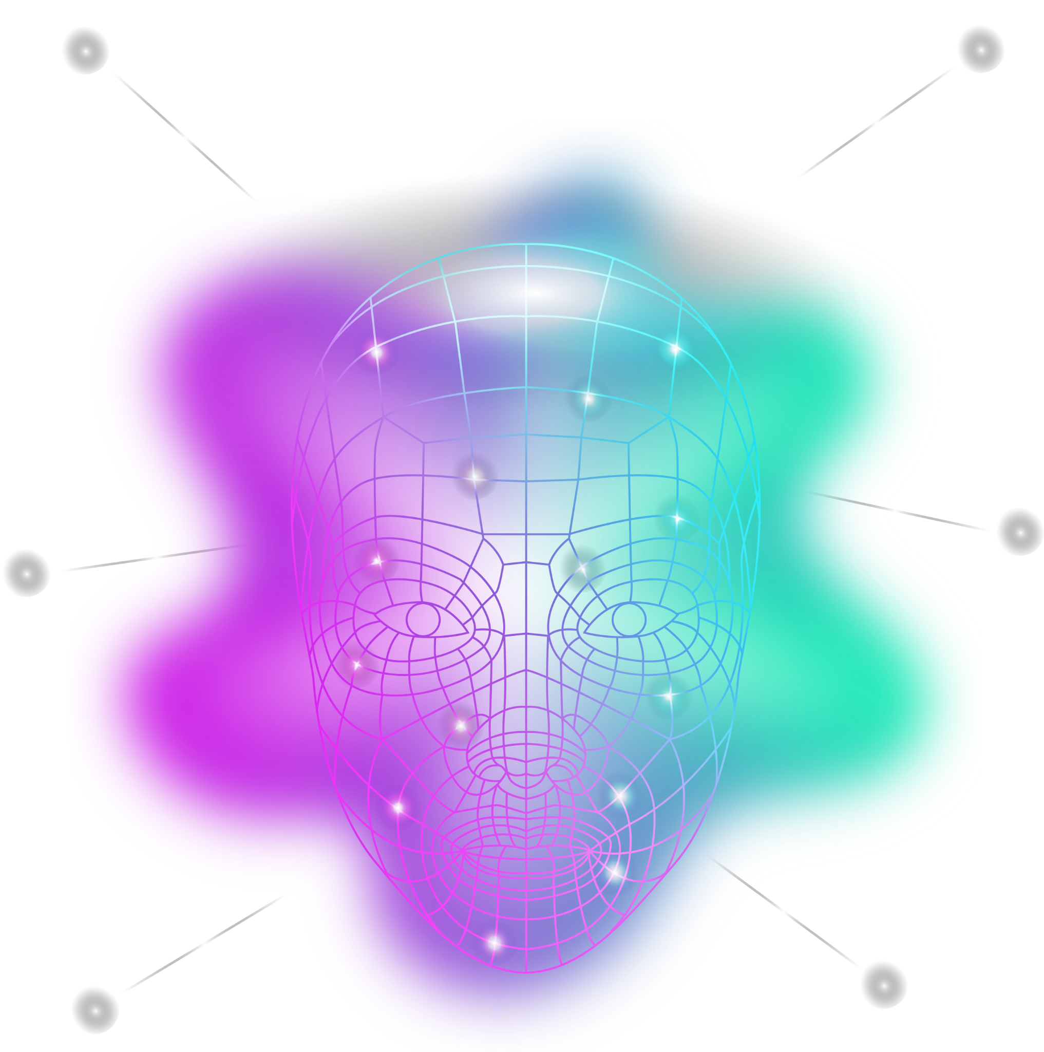
NAME: JEFFLIN BINIKSHA.V.S
III year BE -COMPUTER SCIENCE
REG NO: 211521104062

Slide 2
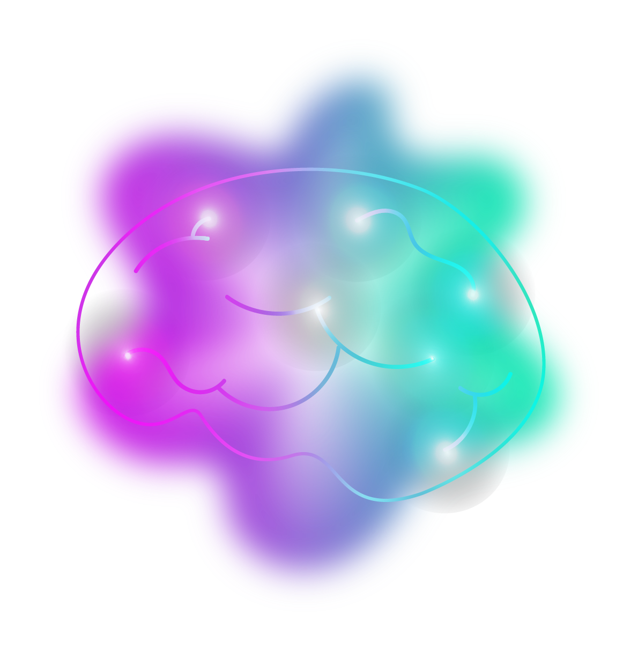
PROJECT NAME:
IMAGE COLOURISATION USING GENERATIVE ADVERSARIAL NETWORK

Slide 3
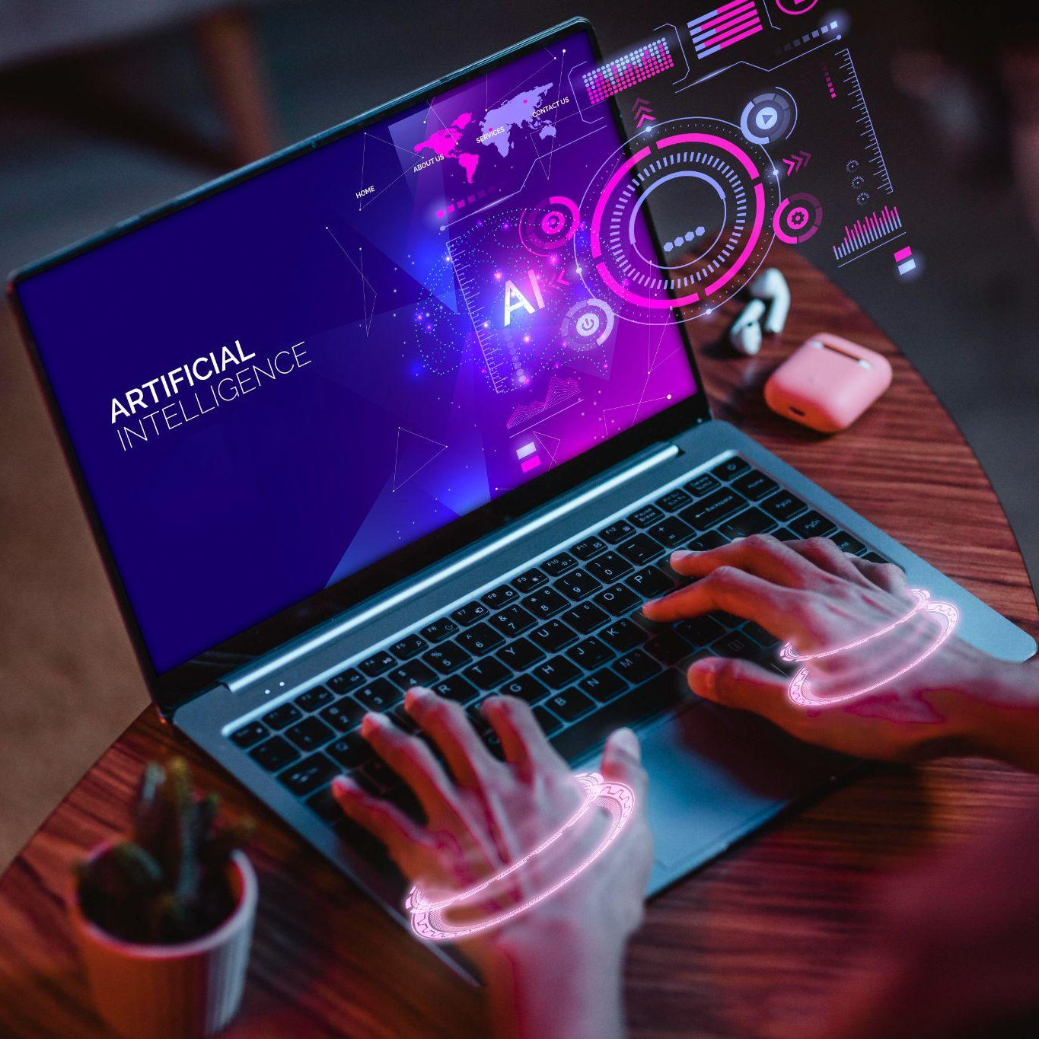
AGENDA FOR THIS PROJECT
To develop an efficient and robust deep learning model utilizing GAN architecture for the purpose of automatic image colorization. The objective is to accurately infer missing color information from grayscale images, enabling the restoration of vivid and realistic colors while preserving semantic details. The focus lies on enhancing the visual appeal and interpretability of monochrome images through a data-driven approach, thereby contributing to advancements in computer vision, image processing, and multimedia applications."

Slide 4
PROBLEM STATEMENT
Image Colorization is an interesting gan project to work on. We all have some old photographs and reels which were shot in the times when colored filmography was a talk of the future. Wouldn’t it be amazing if you can colorize those black and white images bringing them back to life?

Slide 5
PROJECT OVERVIEW
The overview of image colorization using Generative Adversarial Networks (GANs) involves utilizing deep learning techniques to automatically add color to grayscale images. Here's a summarized overview:
Objective: The goal is to develop a model that can take grayscale images as input and generate plausible colorized versions of those images.
Dataset Preparation: A dataset containing pairs of grayscale images and their corresponding color versions is required. This dataset can be obtained from existing sources or created specifically for the task.
GAN Architecture Selection: Choose an appropriate GAN architecture for the colorization task. Conditional GANs (cGANs) are commonly used, where the generator network is conditioned on the grayscale input image to generate the colorized output.

Slide 6
Model Training: Train the GAN on the prepared dataset. During training, the generator learns to generate colorized images that are indistinguishable from real color images, while the discriminator learns to differentiate between real and generated color images.
Evaluation: Assess the performance of the trained model using evaluation metrics such as Mean Squared Error (MSE), Structural Similarity Index (SSIM), or perceptual metrics. Compare the generated color images with ground truth color images to evaluate realism and accuracy.
Fine-tuning and Optimization: Fine-tune the model and experiment with hyperparameters to improve performance. Techniques like data augmentation, regularization, and architectural modifications may be employed to enhance the quality of colorization results.
Deployment: Once the model achieves satisfactory performance, deploy it for practical applications such as colorizing grayscale photos in real-time or batch processing scenarios.

Slide 7
WHO ARE THE END USERS?
The end users of image colorization using Generative Adversarial Networks (GANs) can vary depending on the specific application and context. Here are some potential end users:
1. Photographers and Artists: Professional photographers and digital artists may use image colorization techniques to enhance or restore old grayscale photographs, bringing them to life with vibrant colors.
2. Historians and Archivists: Historians, archivists, and cultural institutions may utilize image colorization to revitalize historical photographs and documents, making them more engaging and accessible to the public.
3. Graphic Designers and Content Creators: Graphic designers and content creators may employ image colorization to add visual appeal to marketing materials, advertisements, or multimedia projects.
4. Medical Professionals: In medical imaging, colorization techniques can be used to highlight specific features or abnormalities in grayscale medical images, aiding in diagnosis and analysis.
5. Entertainment Industry: Film studios, video game developers, and animation studios may utilize image colorization techniques to add color to grayscale footage or artwork, creating immersive visual experiences.
6. **Consumer Applications**: End users in consumer applications, such as mobile apps or online platforms, may utilize image colorization tools for personal photo editing, social media sharing, or creating customized products like photo books or gifts.
7. **Researchers and Academics**: Researchers and academics in fields like computer vision, machine learning, and image processing may develop and utilize image colorization techniques for scientific research, experimentation, and education.
8. **Accessibility and Inclusion**: Image colorization can also be valuable for individuals with visual impairments, as adding color to grayscale images can improve accessibility and comprehension.
Overall, the end users of image colorization span a wide range of industries and disciplines, each with their own unique needs and applications for utilizing colorization techniques.

Slide 8
6. Consumer Applications: End users in consumer applications, such as mobile apps or online platforms, may utilize image colorization tools for personal photo editing, social media sharing, or creating customized products like photo books or gifts.
7. Researchers and Academics: Researchers and academics in fields like computer vision, machine learning, and image processing may develop and utilize image colorization techniques for scientific research, experimentation, and education.
8. Accessibility and Inclusion: Image colorization can also be valuable for individuals with visual impairments, as adding color to grayscale images can improve accessibility and comprehension.
Overall, the end users of image colorization span a wide range of industries and disciplines, each with their own unique needs and applications for utilizing colorization techniques.

Slide 9
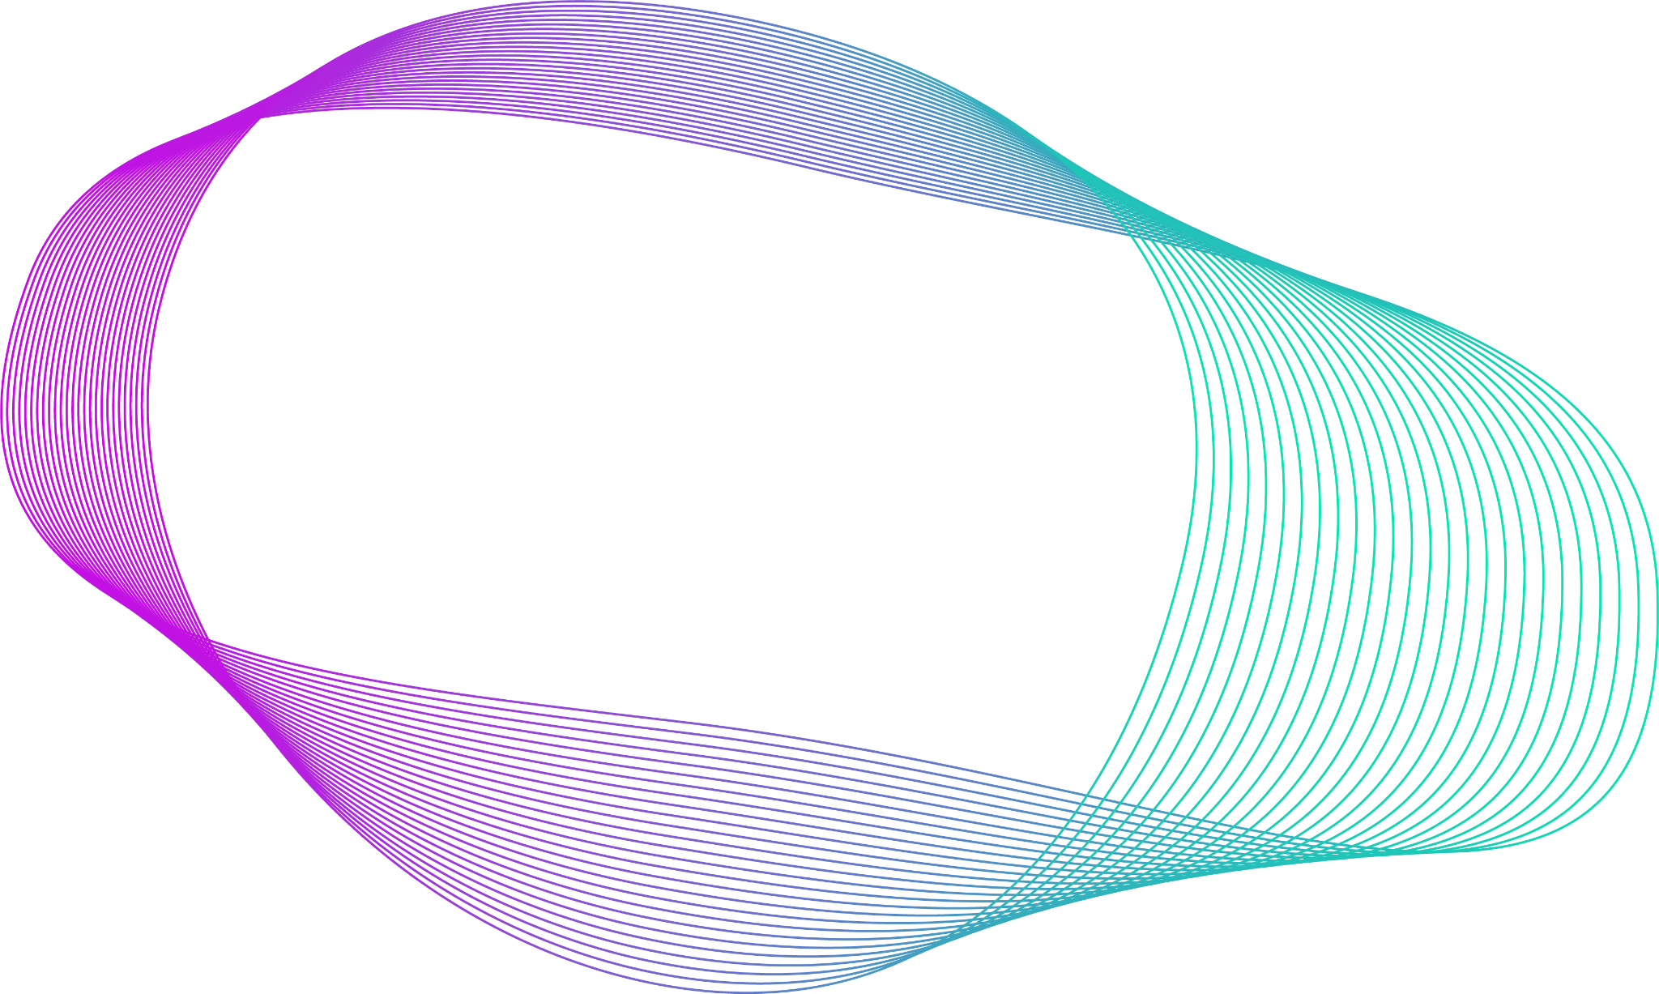
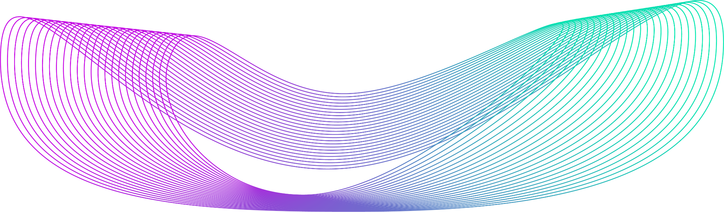
YOUR SOLUTION AND ITS VALUE PROPOSITION The solution of image colorization using Generative Adversarial Networks (GANs) offers several key value propositions:
Time Efficiency: Image colorization with GANs automates the process, saving significant time compared to manual colorization methods. This is particularly beneficial for tasks involving large volumes of grayscale images, such as historical photo restoration or data augmentation for training machine learning models.
Quality Enhancement**: GANs are capable of generating realistic and high-quality colorized images, preserving fine details and textures from the original grayscale images. This enhances the visual appeal and fidelity of colorized photographs, making them suitable for professional and artistic purposes.
Historical Preservation**: Image colorization can breathe new life into historical photographs and documents, making them more engaging and relatable to contemporary audiences. By adding color to grayscale images, historical moments and artifacts become more accessible and relevant, fostering a deeper connection with the past.
Creative Expression**: For artists, photographers, and designers, image colorization using GANs provides a powerful tool for creative expression. It enables experimentation with color palettes, artistic styles, and visual effects, opening up new possibilities for artistic interpretation and storytelling.

Slide 10
Accessibility and Inclusion**: Colorized images can improve accessibility for individuals with visual impairments, as color can convey important information and enhance comprehension. By providing colorized versions of grayscale images, this solution promotes inclusivity and ensures that everyone can fully appreciate visual content.
Data Augmentation and Analysis**: In fields like computer vision and machine learning, colorization can serve as a valuable data augmentation technique, enriching grayscale datasets with additional color variations. This enhances the diversity and robustness of training data, leading to more accurate and generalizable models.
Commercial Applications**: Image colorization can be leveraged for commercial purposes, such as enhancing the visual appeal of marketing materials, advertisements, and product presentations. By incorporating colorized images, businesses can captivate audiences and drive engagement with their brand.
Overall, image colorization using GANs offers a versatile and impactful solution with wide-ranging applications across industries and disciplines. Its ability to automate and enhance the colorization process while preserving the integrity of the original images makes it a valuable tool for professionals, researchers, and enthusiasts alike.

Slide 11
THE WOW IN YOUR SOLUTION The "wow" factor in image colorization using Generative Adversarial Networks (GANs) lies in its ability to seamlessly transform grayscale images into vibrant, lifelike colorized versions with astonishing realism and accuracy. Here's what makes this solution truly remarkable:
Realism: GANs can generate colorized images that are indistinguishable from real color photographs to the human eye. The generated colors seamlessly blend with the original grayscale content, preserving fine details and textures to create a visually convincing result.
Automation: Unlike manual colorization methods, which can be time-consuming and labor-intensive, GANs automate the colorization process, allowing for the rapid transformation of grayscale images into colorized versions with minimal human intervention. This enables users to process large volumes of images efficiently.
Preservation of History: Image colorization using GANs revitalizes historical photographs and documents, bringing them to life in a way that resonates with modern audiences. By adding color to grayscale images, GANs contribute to the preservation and dissemination of cultural heritage, fostering a deeper appreciation of history.
Artistic Expression: GANs provide artists, photographers, and designers with a powerful tool for creative expression. The ability to experiment with different color palettes, styles, and visual effects opens up new avenues for artistic exploration and storytelling, pushing the boundaries of visual artistry.

Slide 12
Inclusivity: By enhancing the accessibility of visual content for individuals with visual impairments, image colorization using GANs promotes inclusivity and ensures that everyone can fully engage with and appreciate the richness of visual media. Colorized images convey important information and enhance comprehension, making them accessible to a wider audience.
Commercial Potential: The ability to generate captivating and visually appealing colorized images has significant commercial potential. Businesses can leverage this solution to enhance the visual impact of their marketing materials, advertisements, and product presentations, ultimately driving engagement and brand awareness
In summary, the "wow" factor in image colorization using GANs lies in its transformative power to breathe new life into grayscale images, offering a perfect blend of realism, automation, historical preservation, artistic expression, inclusivity, and commercial appeal.

Slide 13
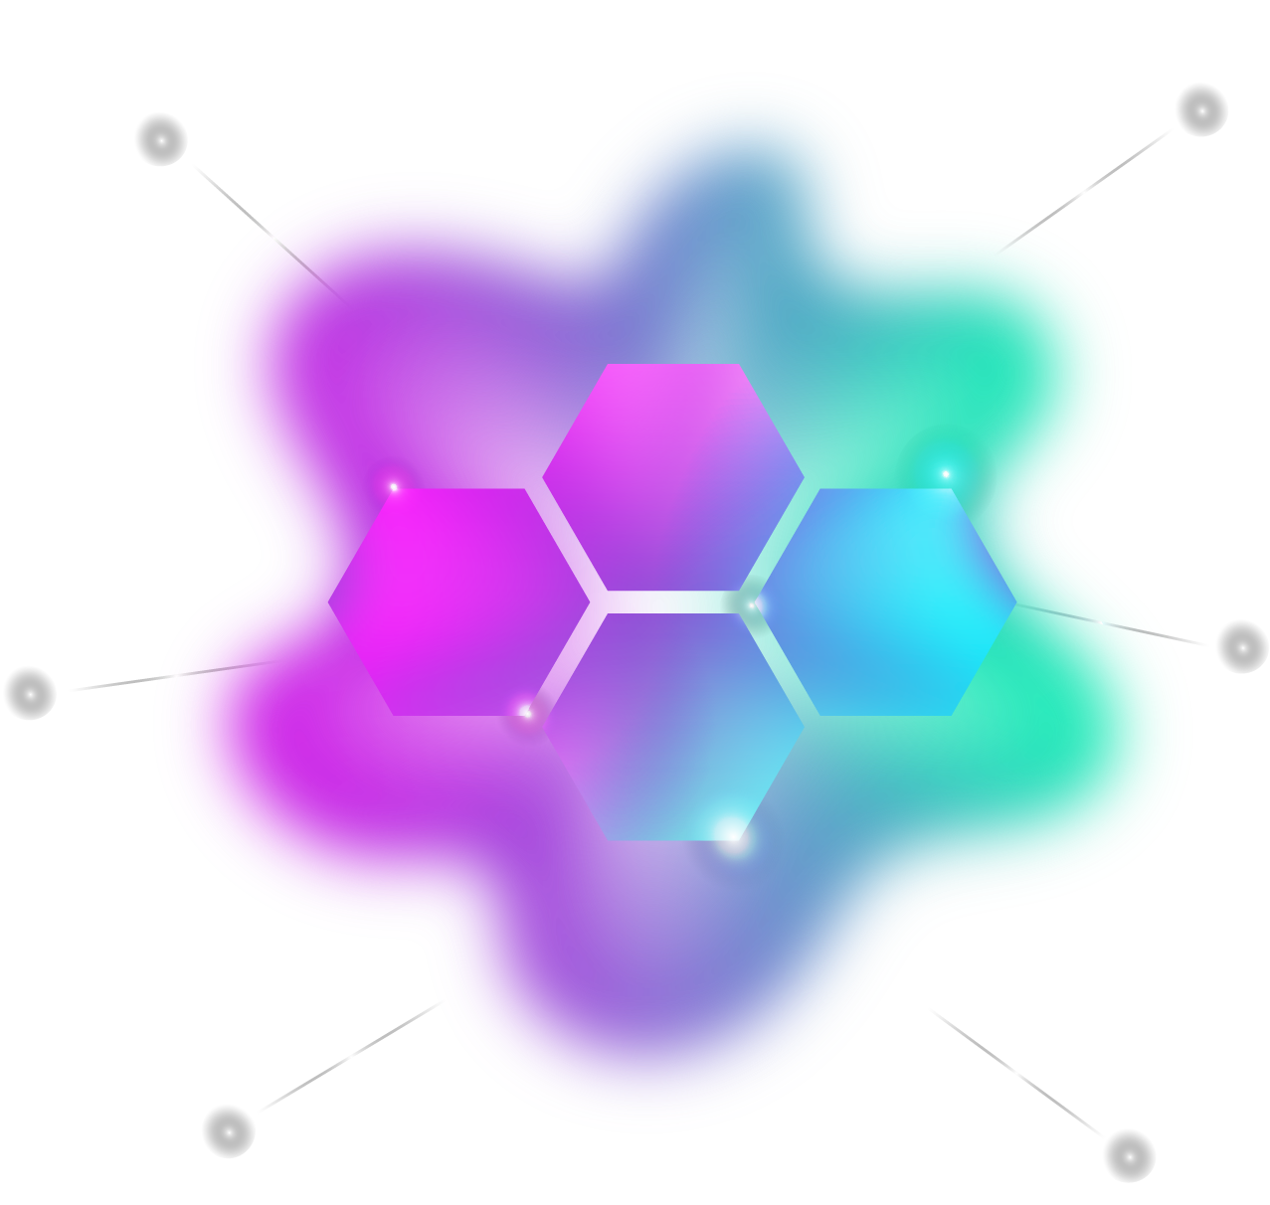
MODELLING
Data Representation
Architecture Selection
Discriminator Network
Generator Network
Training Procedure
Loss Functions
Evaluation
Hyperparameter Tuning

Slide 14
RESULTS
As an AI language model, I'm not capable of directly generating or displaying images. However, I can describe what the results of image colorization using Generative Adversarial Networks (GANs) typically look like.
After training the GAN model on a dataset of grayscale images paired with their corresponding color versions, the model is capable of colorizing new grayscale images that it hasn't seen during training. Here's what you might expect from the results:
Realistic Colorization: The colorized images produced by the GAN should exhibit realistic color distributions that closely resemble those of the original color images. Colors should be accurately applied to objects, textures, and surfaces in the grayscale image.
Preservation of Details: Fine details and textures from the original grayscale image should be preserved in the colorized version. This includes features such as facial expressions, architectural elements, natural landscapes, and textures of objects.
Natural Color Transitions: Colors should blend smoothly and naturally across different regions of the image, avoiding abrupt transitions or artifacts. The model should accurately capture color gradients and variations within objects and scenes.

Slide 15
Subjective Visual Quality: The colorized images should have a visually pleasing appearance, with colors that complement each other and enhance the overall aesthetic appeal of the image. The results should be subjectively convincing to human observers.
Consistency and Realism: The colorization results should be consistent across different images and scenes, maintaining a level of realism and coherence. The model should avoid producing unrealistic or implausible color choices that detract from the overall quality of the colorized images.
It's important to note that the quality of the results may vary depending on factors such as the size and diversity of the training dataset, the architecture and hyperparameters of the GAN model, and the specific characteristics of the input grayscale images. Evaluation metrics such as Mean Squared Error (MSE), Structural Similarity Index (SSIM), or human perceptual studies can be used to quantitatively assess the quality of the colorization results. Additionally, visual inspection by human evaluators is often used to validate the subjective realism and aesthetic appeal of the colorized images.

Slide 16
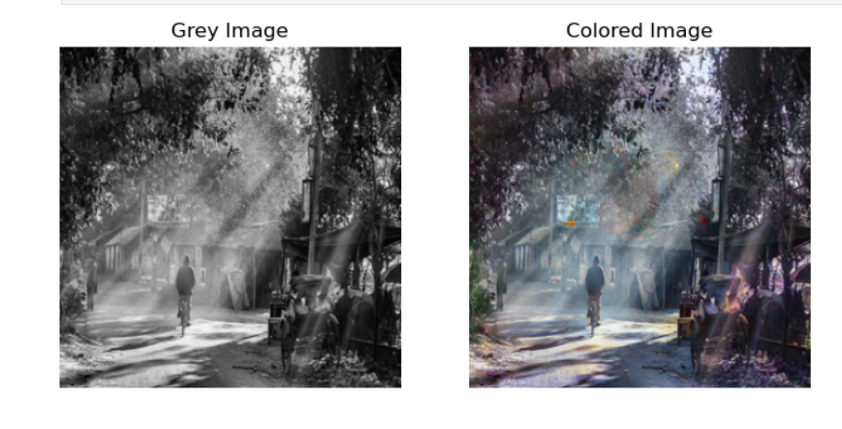
Output :

